Slide 1
Music for the Mood
By Rose Montoya

Slide 2
Budding Data Scientist
Started studying data science eight months ago at entity academy through a bootcamp program.
Actress
Moved out to LA at 18 to study acting at a conservatory.
Server
At a little family-owned cuban restaurant.
International Baccalaureate Graduate
Who am I?

Slide 3
Purpose of Project:
To classify songs into different mood categories based off of audio features using machine learning.
Notes:
The idea for this project developed earlier this year when I was going through some major life changes. During those difficult times, it was music I turned to. I started carefully curating a playlist of positive songs to boost my mood.
However, I found myself dissatisfied at the song recommendation given to me by spotify. Note, at the time, enhanced playlists did not exist. It was in that desire for better song recommendation this project was born.
I wanted to be able to make a music recommendation system that recommended songs not only by the auditory similarities, but also by the lyrical content that matched. While I do not dive into the full scope of that project, I do take the first steps in making that goal a reality.
The purpose of this project is to discover how well songs can be classified into different mood categories based off of audio features. This is done in the hopes that one day it will be used in conjuncture with lyrical analysis that will be able to place songs into categories based off of content. And then recommend songs with similar lyrical and auditory features.

Slide 4


Finding the Data
Used Spotify’s API and spotipy to create own dataset.
The dataset contains tracks from Spotify’s mood playlists.
Merged playlists together to achieve a count of 200 tracks per mood.

Slide 5
Moods
01
02
Happy
Chill
03
Sad
04
05
Romance
Confidence
Positive, upbeat music to put you in a good mood.
Music to wind down with and relax.
Music to cry along with and pour your heart into.
Love songs that make your heartbeat flutter and give you dreamy eyes.
Music to boost your confidence and make you feel like a boss.

Slide 6
Audio Features
Duration(ms): The length of the track in milliseconds.
Popularity(0 -> 1): How many plays does the track have.
Key(0 to 11): Integers correlated to standard pitch class notation.
Danceability(0 -> 1): How suitable the track is for dancing.
Energy(0 -> 1): A measure of intensity and activity in a track.
Loudness (-60 to 0): The average volume of a track in decibels with 0 being the loudest.
Mode(0/1): Denotes if a track is in a minor(0) or major(1) key.
Speechiness(0 -> 1): The spoken word value of a track.
Acousticness(0 -> 1): How much electrical amplification the track contains.
Instrumentalness(0 -> 1): Predicts how much vocals are on a track.
Liveness(0 -> 1): The likelihood the track was record live.
Valence(0 -> 1): The positiveness of a track .
Tempo(bpm): The pace of track or how many beats per minute.
Explicit(T/F): Whether the track contains explicit content.

Slide 7
What’s the Difference?

Slide 8
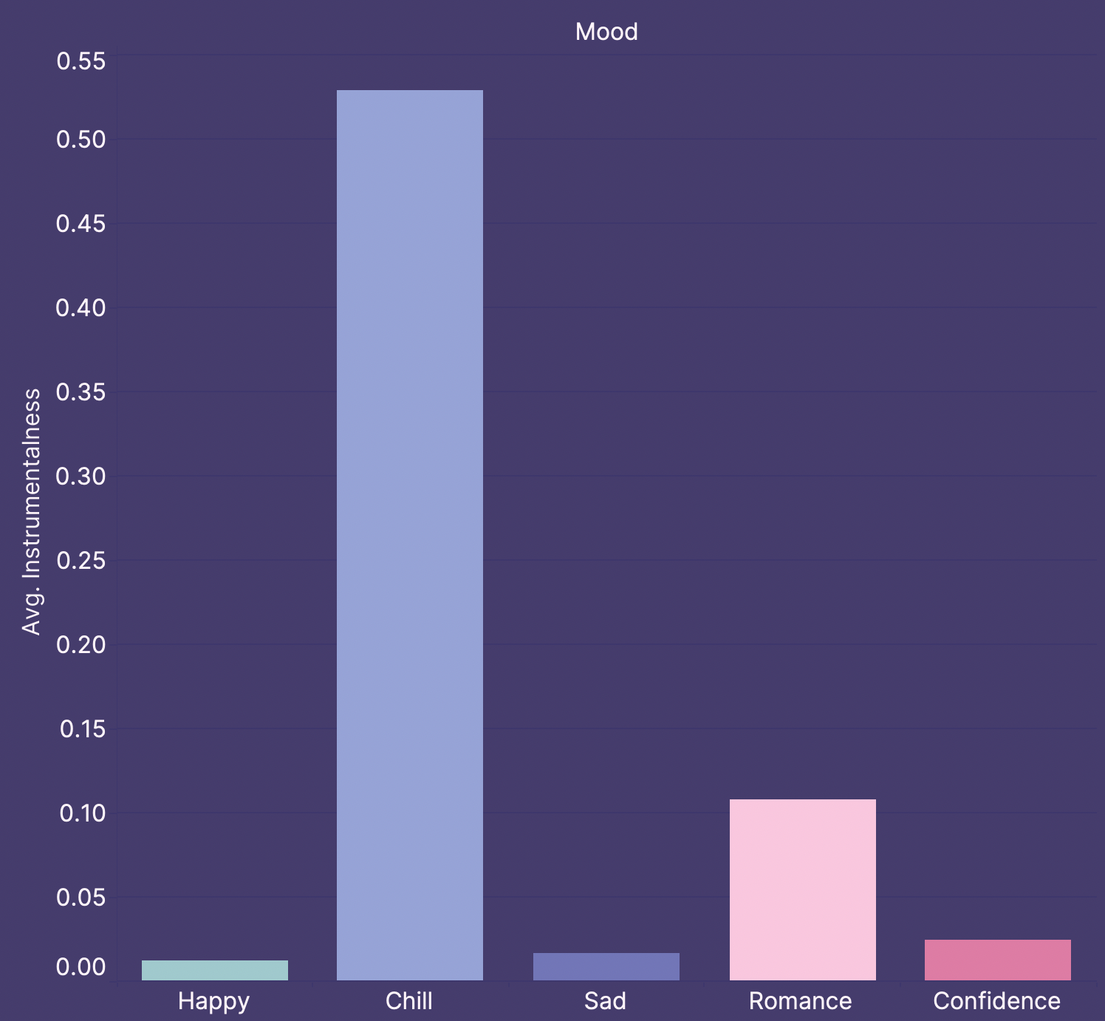
Instrumentalness
Chill has a much higher instrumental level than all of the other categories.
Happy, Sad and Confidence have basically no instrumentalness.
Romance has a little, but still a lot less than Chill.

Slide 9
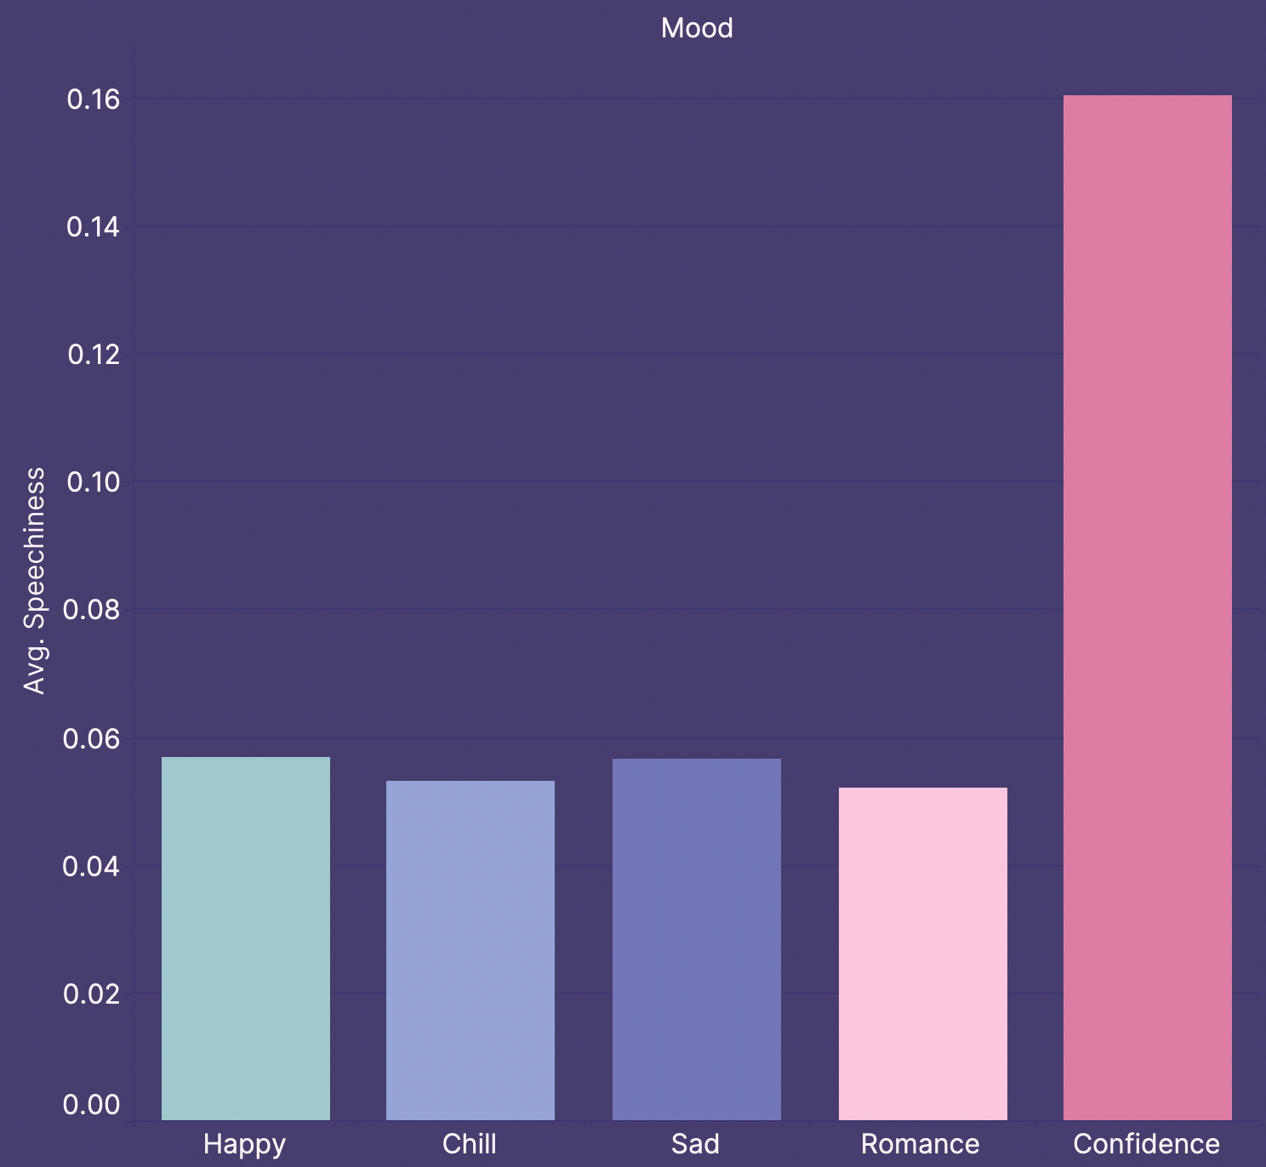
Speechiness
Confidence has a much higher speechiness level at a 16% average.
All of the other categories are relatively the same falling between a 5-6% average.

Slide 10
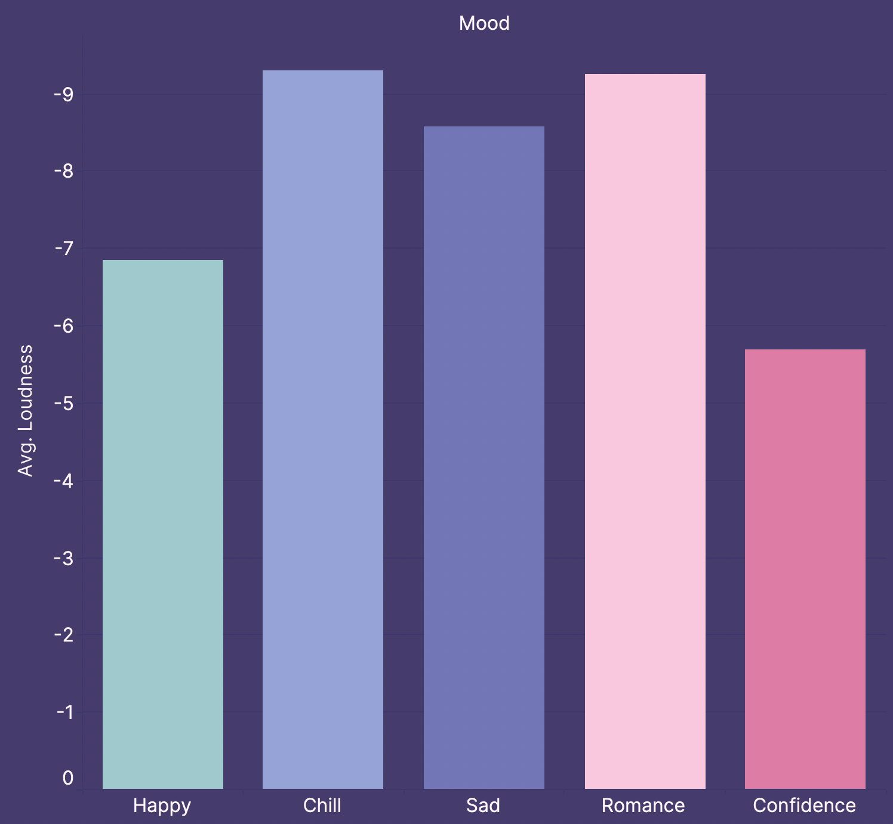
Loudness
Confidence has the loudest tracks followed by Happy.
Chill, Sad, and Romance have about the same loudness and are quieter than the other two.

Slide 11
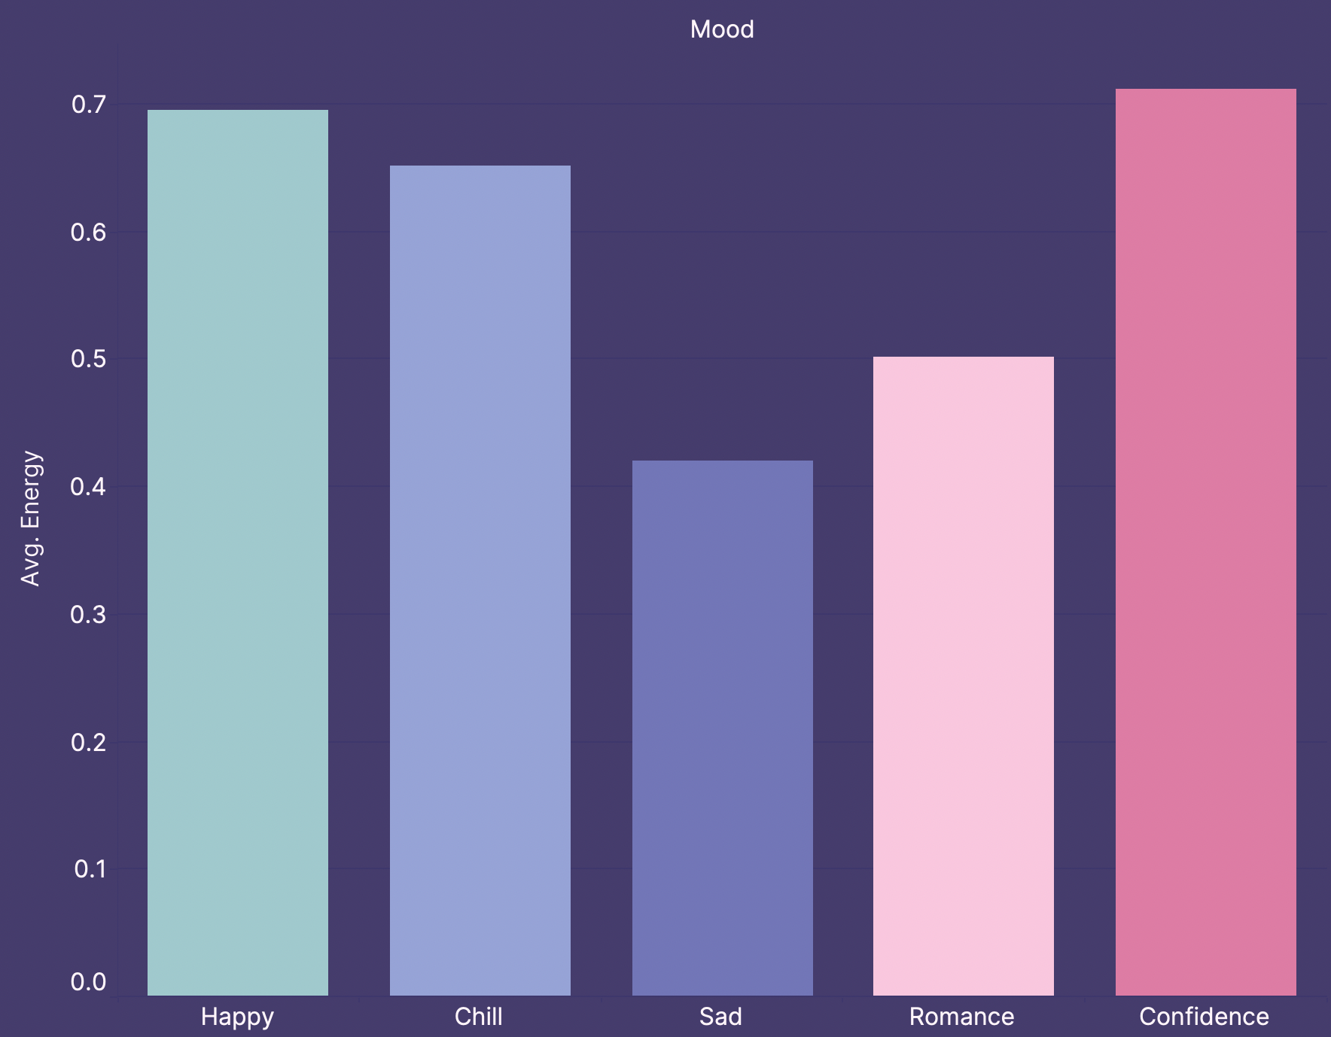
Energy
Sad has the lowest energy at 40%, a lot less than Happy, Chill and Confidence at ≈70%.
Romance also has a lower energy at 50%, but not as low as Sad.

Slide 12
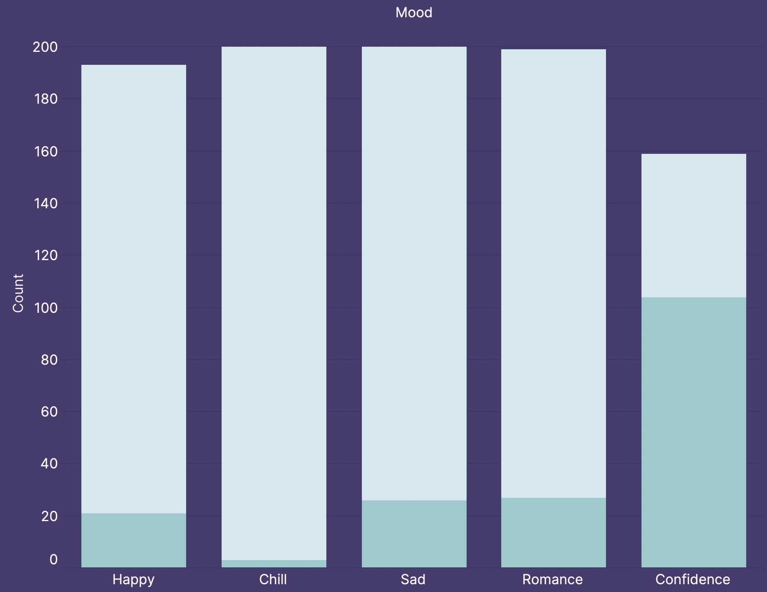

Explicit
Confidence has a lot more explicit songs than the other categories with over half the tracks being labeled explicit.
Chill has basically no explicit tracks.
About 10% of Happy, Sad, and Romance tracks are explicit.

Slide 13
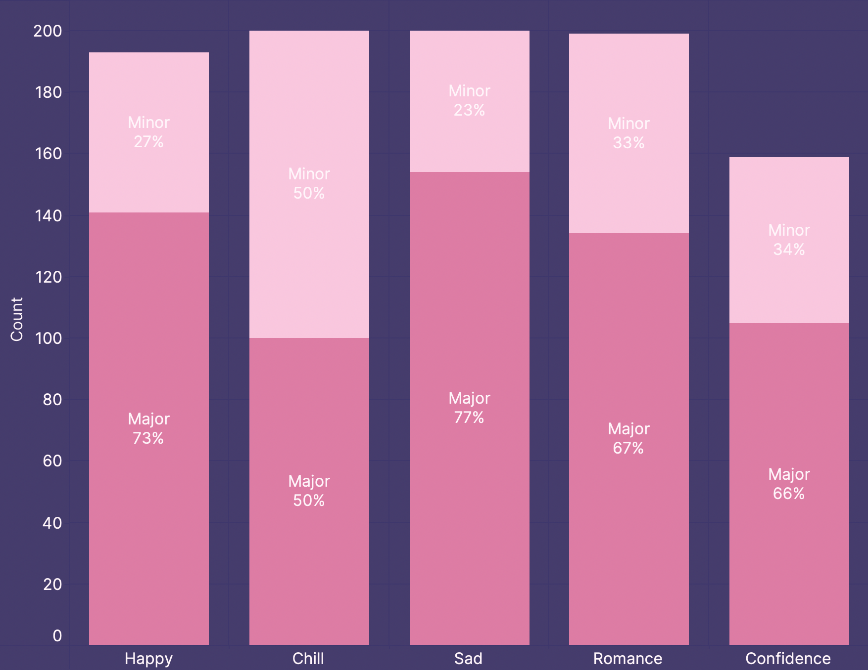
Mode
Sad has the most tracks with a major key, closely followed by Happy.
Chill has the most tracks with a minor key, with an equal amount of minor and major tracks.

Slide 14
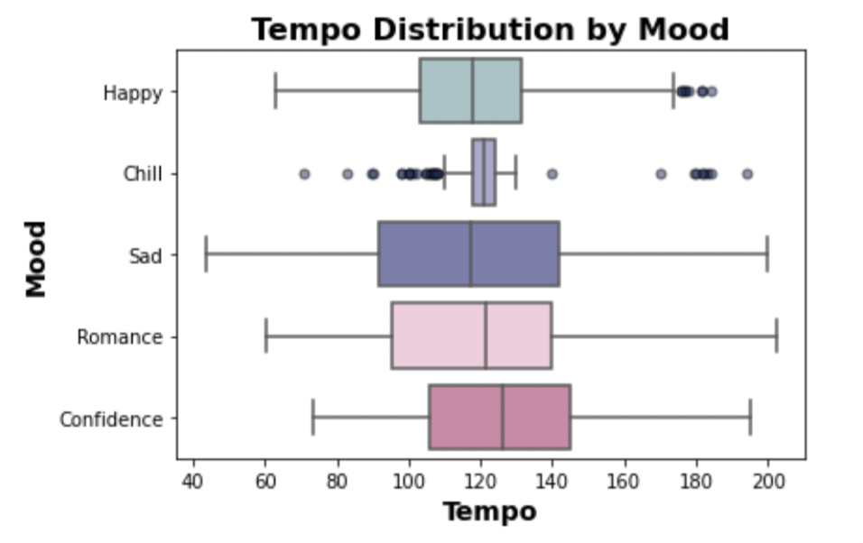
Tempo
Chill has a much smaller distribution of tempo with more outliers.
Sad has more slow songs than the other categories, and is spread out across the whole tempo range.
Most tempos fall around 120 bpm.

Slide 15
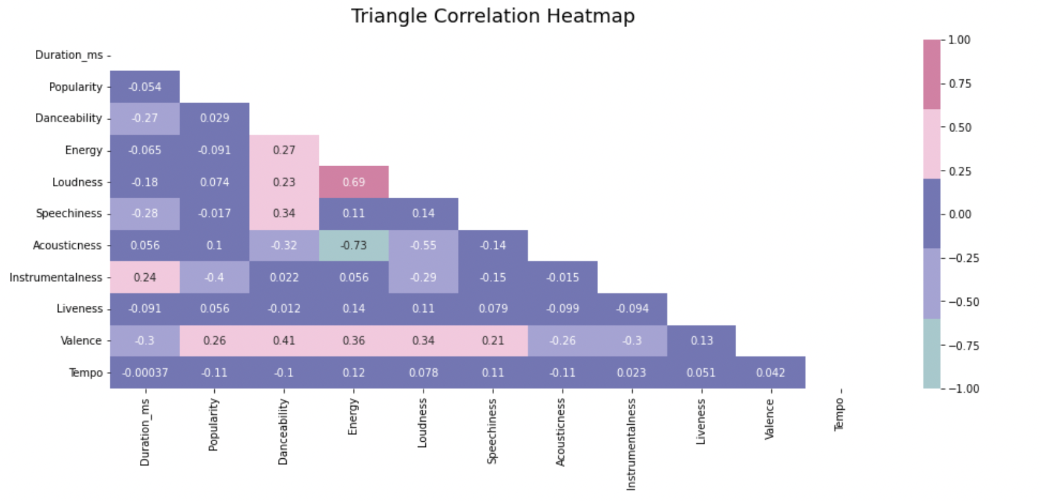
Feature Correlation
Feature Correlation

Slide 16
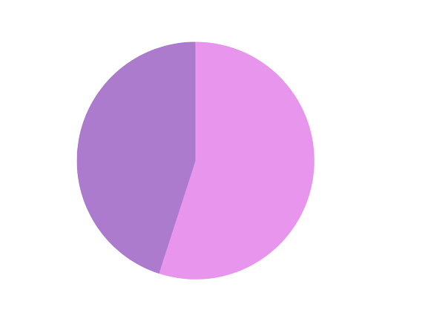
Outliers
Outliers
438
46%
An Outlier is any data point that lies outside of the normal data range. This can be seen using box plots. Outliers were found for each individual audio feature and combined into a master list.
Non-Outliers
513
54%

Slide 17
Extreme Outliers
Duration: Most songs fell within 1 min 40 secs and 6 min 40 secs. Did you know that Taylor Swift has a ten minute version of All Too Well?
Popularity: There were two songs with zero popularity and one with one popularity. All of them were released on the day the dataset was made.
Loudness: There was only one song less the -25 dB in volume.
Speechiness: There was only one track with a speechiness level higher than 0.5
Tempo: Only one track had a bpm less than 60.

Slide 18
Datasets
All
No Out
No Ex
Complete Dataset
All Outliers Removed Dataset
Extreme Outliers Removed Dataset
This dataset contains all the tracks from each mood category for a total of 951 tracks.
This dataset only has the most extreme outliers removed for a total of 939 tracks.
This dataset contain only that tracks were not outliers for any of the features, a total of 531 tracks.

Slide 19
KNN or Random Forest

Slide 20
KNN Results
Dataset All
Accuracy of 65% with 23 neighbors.
Dataset No Out
Accuracy of 55% with 35 neighbors.
Dataset No Ex
Accuracy of 73% with 19 neighbors.

Slide 21
Random
Forests

Slide 22
Results
 | Standard Random Forest | With Hyperparameter Tuning
Dataset All | 77% | 78%
Dataset No Out | 68% | 68%
Dataset No Ex | 71% | 72%

Slide 23
Removing Low
Variance Features
Features: Duration, Popularity, Key, Loudness, Mode, Acousticness, Tempo, and Explicit.
Feature Selection
Features: Popularity, Danceability, Energy, Speechiness, Acousticness, Instrumentalness, and Valence.
Accuracy: 69%
Accuracy: 75%

Slide 24
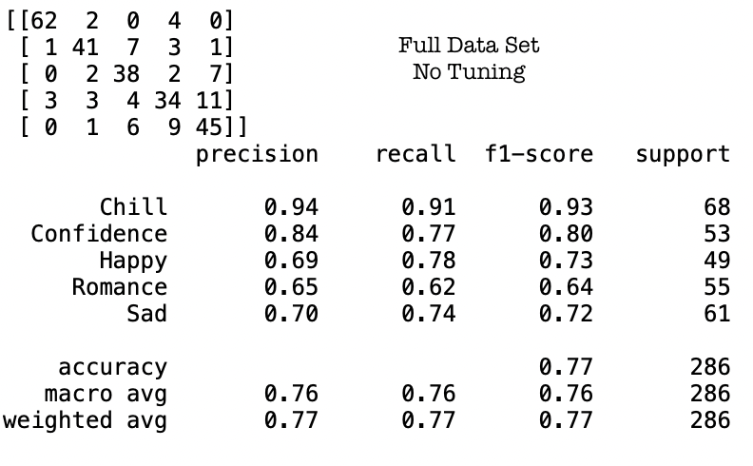
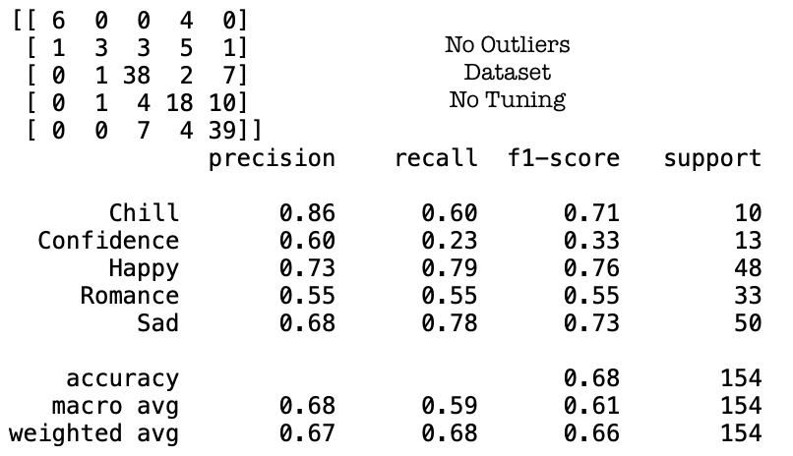
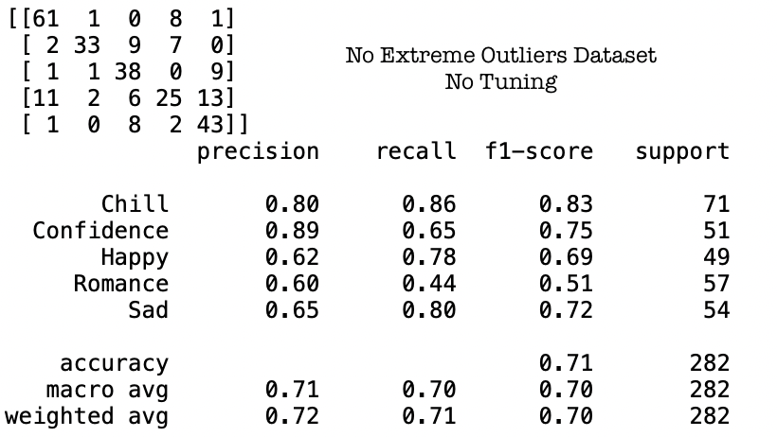

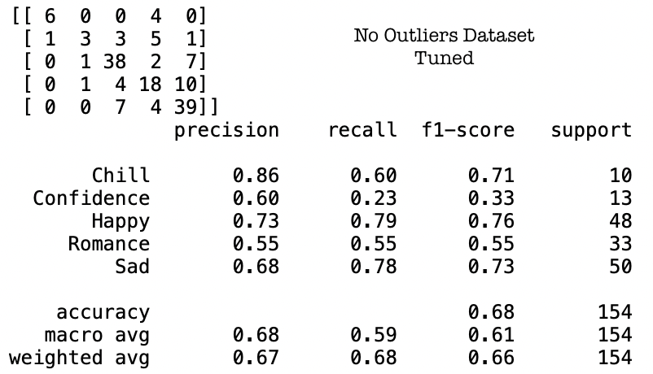
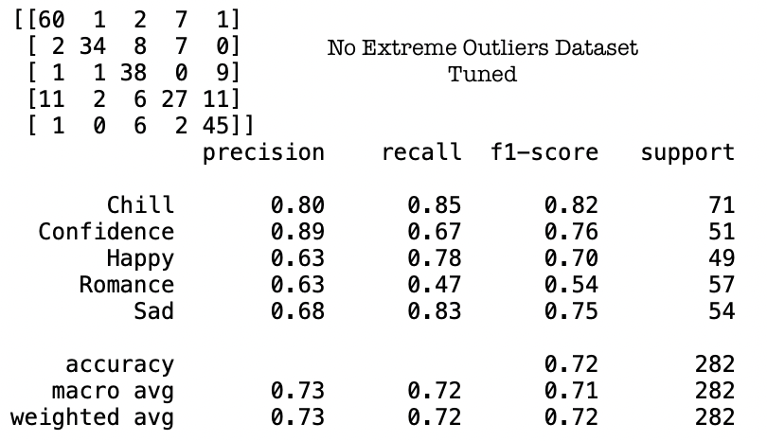
Taking a Closer Look

Slide 25
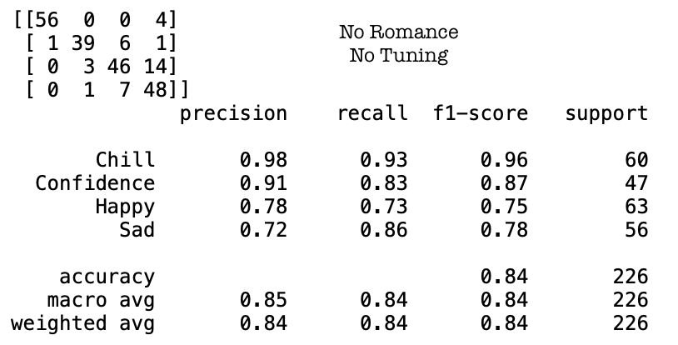
Removing Romance
The Best Model

Slide 26
Summary:
5 Moods
All Tracks
Hyperparameter Tuning
78%
84%
4 Moods
All Tracks
No Tuning

Slide 27
What’s Next
Lyrics
Audio Features
+
Lyrics
Recommender
Natural language processing on the lyrics of the songs with the same moods.
Build a music recommendation system based on both audio features and Lyrical qualities.
Look at how the audio features and lyrics work together in the creation of a mood.

Slide 28
Conclusion:
Why Does This Matter?
Notes:
Music is powerful. Music is transformative. Music is magical.
This project, and the continuation of it moving forward, is to create something that enriches people’s experience of living life. Life can get so hard sometimes, and it’s the little beauties like the perfect song, that really remind you of how beautiful life can be.
Being able to find songs that speak to your soul, that speak your situation in life, provides incredible enrichment.

Slide 29
Thanks!
Do you have any questions?
Linkedin
GitHub
Please keep this slide for attribution

Slide 30
Citations
Spotify x Billboard Top 20 Albums Five Year Analysis Project
By Bianca Serrano and Katie Ravenwood
https://github.com/Beeserra/Spotify-Five-Year-Analysis-Project
Get Tracks’ Audio Features
https://developer.spotify.com/documentation/web-api/reference/#/operations/get-several-audio-features
Feature Selection Techniques
By Maria Gusarova
https://medium.com/@data.science.enthusiast/feature-selection-techniques-forward-backward-wrapper-selection-9587f3c70cfa
Feature Selection Using Random forest
By Akash Dubey
https://towardsdatascience.com/feature-selection-using-random-forest-26d7b747597f

